Slide 1
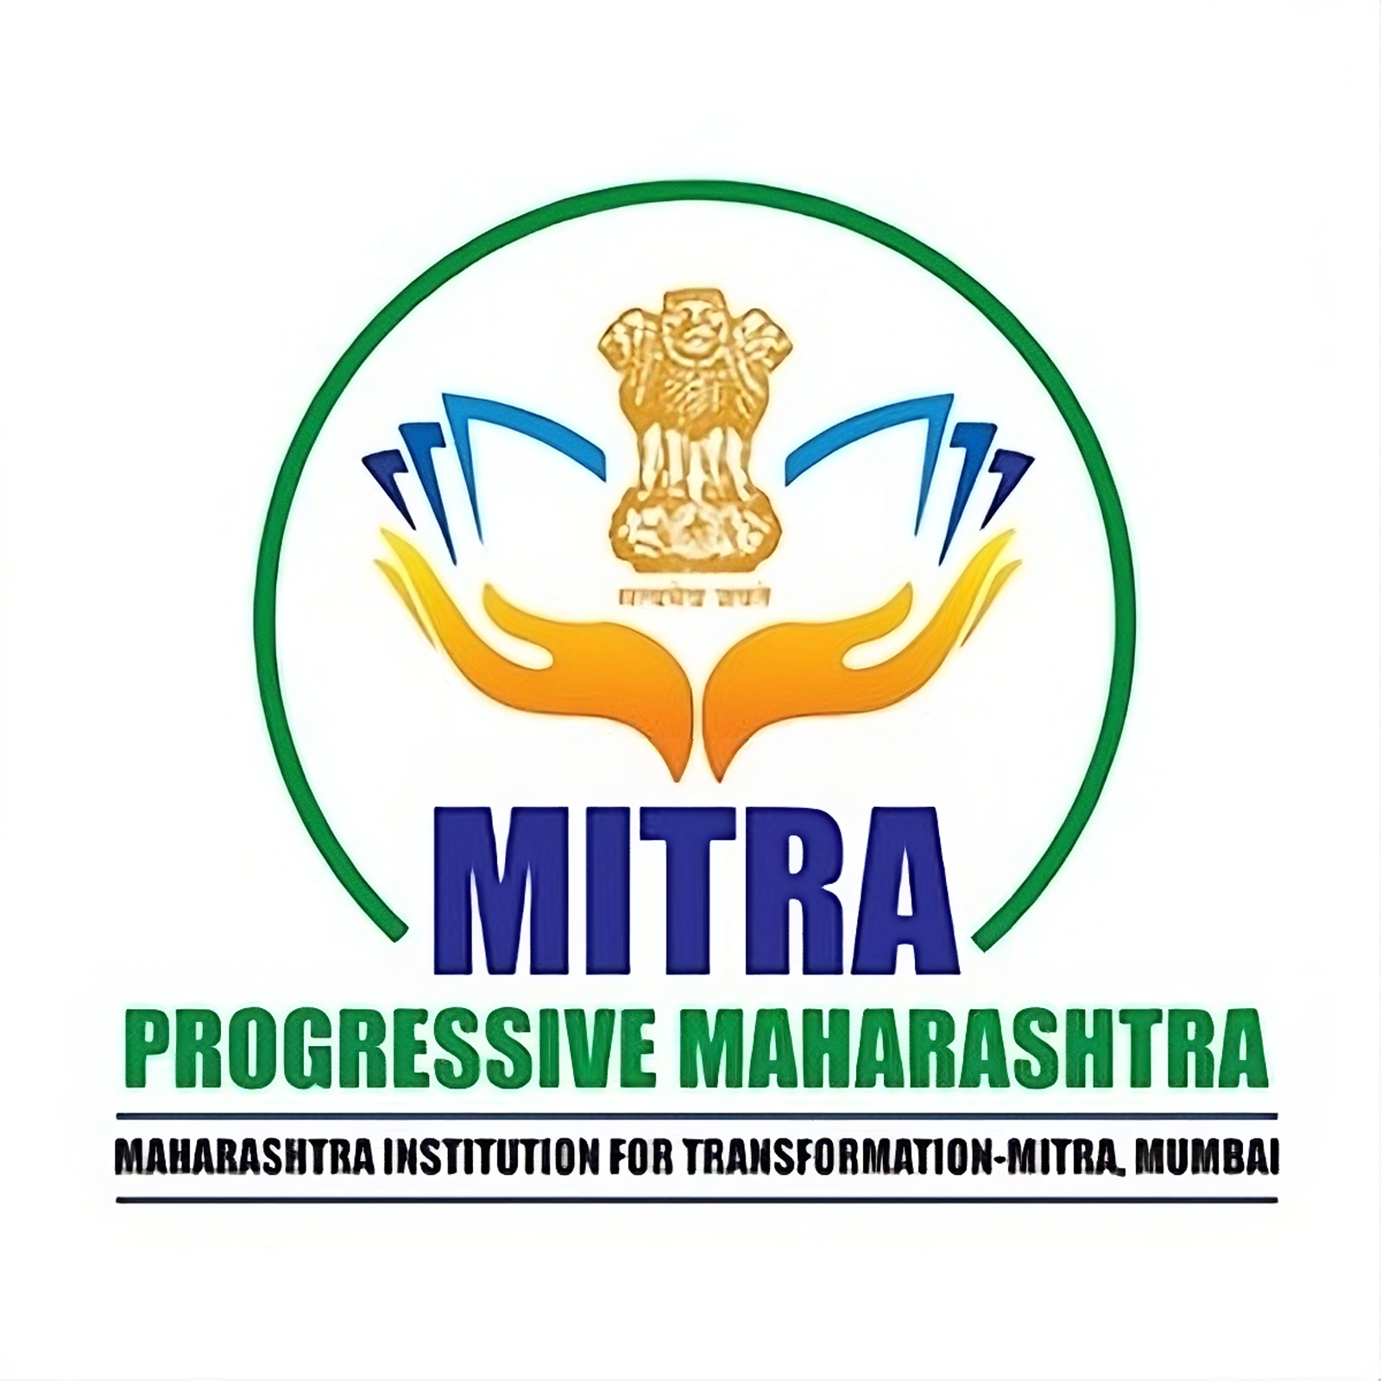

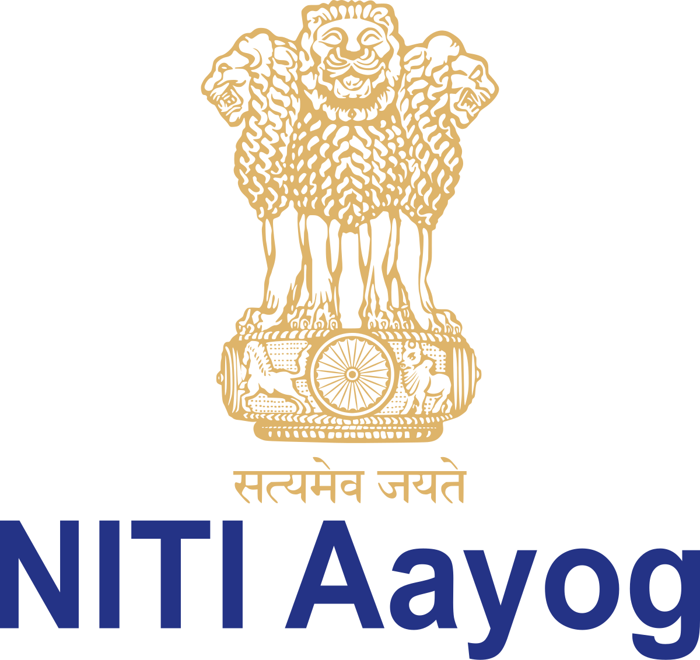
Policy Framework: Setting up Foreign Higher Education Institutes (FHEIs) in the State of Maharashtra per National Education Policy (NEP) 2020
By Aaditya Agarwal: Maharashtra Institute of Transformation, National Institute for Transformation (NITIAayog: Government of India’s Policy Think Tank Chaired by Prime Minister)

Slide 2
Background Information
Aaditya Agarwal: Maharashtra Institute of Transformation, National Institute for Transformation (NITIAayog: Government of India’s Policy Think Tank Chaired by Prime Minister)
Around 700,000+ students study abroad annually, which causes India to lose $60 billion in Foreign Exchange outflows. (ICEF Monitor). Thus, the National Education Policy (NEP) 2020 released by the Ministry of Education of the Government of India aims to promote the entrance and operation of campuses of top Foreign Higher Educational Institutions (FHEIs).
The University Grants Commission (UGC) released the FHEI regulations in 2023, outlining operational autonomy, eligibility criteria, and other important information.
Maharashtra, accounting for 12.92% of India’s GDP, also the leading state in terms of GDP with a large population of 12.57 Crore, has positioned itself to be the Education Hub of India, a vision repeatedly highlighted by Chief Minister Devendra Fadnavis. (Reserve Bank of India) This is seen with the launching of EduCity, a 250-acre region near Navi Mumbai, aiming to provide prestigious education opportunities to students in Mumbai, Maharashtra and India at large. (Indian Express)

Slide 3
FHEIs are being set up in Maharashtra with the goal of lowering brain drain, offering quality education at an overall lower cost to Indian students, and building prestige similar to models such as Dubai’s Academic City, Singapore’s Global Schoolhouse or GIFT City in Gujarat.
There currently exist certain key problems to resolve in this regard: such as high land costs, uncertainty around taxation rules, fragmented regulatory approvals, lack of clarity on repatriation and degree equivalence for all professions, and many others.
Firstly, countries such as the US, Australia and Canada have introduced stricter regulations on international student visas, (Gallagher) which reduces the number of Indian students who can attain a degree from these prestigious universities. Budget cuts in universities, primarily due to reduced government funding has led to some universities downsizing and thus de-prioritizing foreign applicants. (Redden)
Having the largest youth population in the world, (United Nations) with 40 million students in higher education, (AISHE) there is surely to be a continuous demand for higher education in India. Further, the expanding Indian middle class increasing ambitions to study abroad is can not be catered to for these FHEIs.

Slide 4
Policy Requirements Cost of Land: The Current Problem
Aaditya Agarwal: Maharashtra Institute of Transformation, National Institute for Transformation (NITIAayog: Government of India’s Policy Think Tank Chaired by Prime Minister)
Land is currently unsustainably expensive in industrial and urban hubs, such as Navi Mumbai, costing around $149 million just to purchase the land required for a 25 Acre University. (Maharashtra Real Estate Regulatory Authority).
In contrast, this would cost only around $11-17 million in the United States because of subsidized land costs, as with Cornel Tech (Cornell University). (Refer to Figure 1)
Dubai’s Education Hub costed merely $44,000 and Indonesia and Singapore have similarly subsidised FHEIs to resultantly cost $1 million and $42 million for the set up, respectively.

Slide 5
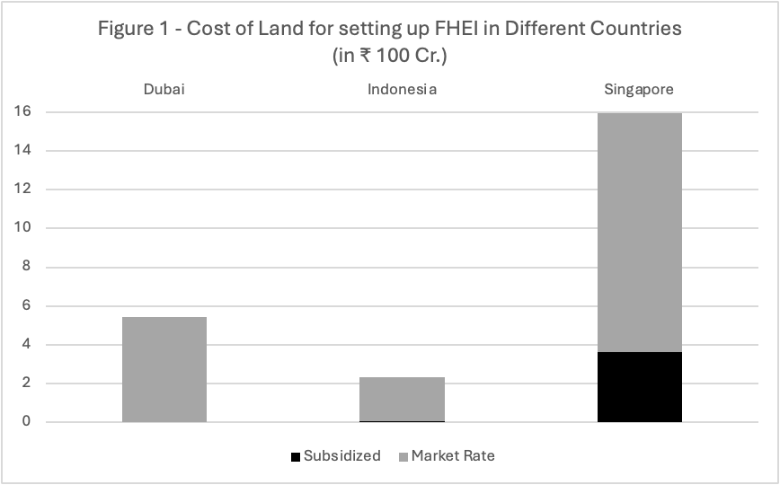

Slide 6
Cost of Land: The Way Forward
Aaditya Agarwal: Maharashtra Institute of Transformation, National Institute for Transformation (NITIAayog: Government of India’s Policy Think Tank Chaired by Prime Minister)
The State of Maharashtra must offer land at a subsidized rate to approximately match the cost to set up in the United States and the cost to set up FHEI campuses in other countries, specifically: below ₹1,000, ($11.7) per sq. ft.
This can be achieved by donating land, reducing rent, subsidizing rates, providing grants to decrease cost of land, etc.
The IFSC special education zone within GIFT City in India is a notable example of success, where institutions such as Deakin University and University of Wollongong have began setting up. (Refer to Figure 3)

Slide 7
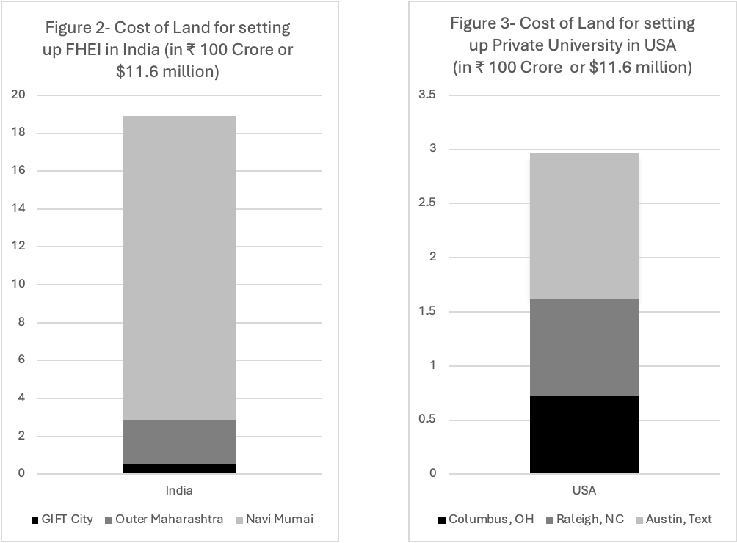

Slide 8
Taxation Policy: The Current Problem
Aaditya Agarwal: Maharashtra Institute of Transformation, National Institute for Transformation (NITIAayog: Government of India’s Policy Think Tank Chaired by Prime Minister)
As FHEIs are likely to operate as for-profit institutions, they currently do not quality for traditional tax exemptions enjoyed by Indian education services operating on a not-for-profit model.
This irregularly high tax contribution required acts as a deterrent to set up branch campuses including a burdensome 40% corporate income tax, 2% tax on hybrid models for FHEIs that offer online classes from its home campus as Equalisation Levy, 18% Goods and Services Tax on revenue, and 6% stamp duty tax on land transactions.
In the United States, these elite universities are exempt from federal income tax and receive property waivers through 501(c)(3), a notable difference in setup costs.
Double Taxation Avoidance Agreements to avoid double taxation on income earned and profit repatriated currently involves complicated documentations, as the law currently lacks a standard tax structure for FHEIs.

Slide 9
Taxation Policy: The Way Forward
Aaditya Agarwal: Maharashtra Institute of Transformation, National Institute for Transformation (NITIAayog: Government of India’s Policy Think Tank Chaired by Prime Minister)
The State of Maharashtra should firstly provide exemption to FHEIs from GST, and income tax as applicable to not-for-profit institutions, or offer a lower tax rate for the initial period.
Additionally, tax holidays of 10 years, as applied to Gujarat’s GIFT City, (IFSCA) should be offered.
The Maharashtra Government must solve the ambiguity around PE status to prevent 40% taxation (as opposed to the 1.4% corporate tax in the US), by creating a caveat for academic institutions, and directing the Central Board of Direct Taxes to provide clarification on the status of FHEIs.
Further, assistance in navigating and structuring DTAA obligations and during the onboarding process will increase the ease of setting up branch campuses, and exemptions for the equalization levy must be considered by the Government.

Slide 10
Regulatory Clarity: The Current Problem
Aaditya Agarwal: Maharashtra Institute of Transformation, National Institute for Transformation (NITIAayog: Government of India’s Policy Think Tank Chaired by Prime Minister)
There is a lack of inter-ministerial coordination for the required approvals for an FHEI. The UGC is intended to act as a single platform for all FHEI related approvals, yet many additional government agencies have independent approval processes reducing overall efficiency.
The independent operation of these ministries with asynchronized timelines means approvals for FHEI rollout can often take months.
Further, the UGC Guidelines of 2023 grant equivalence to all foreign degrees except professional degrees of Medicine, Law, Architecture, Pharmacy and Nursing which means FHEIs specializing in and offering these courses are unlikely successful as individuals wishing to pursue professions in India would still require Indian licensure and certification to practice. (around 20% of those who currently study abroad aim to specialize in these professions; Refer to Figure 4)

Slide 11
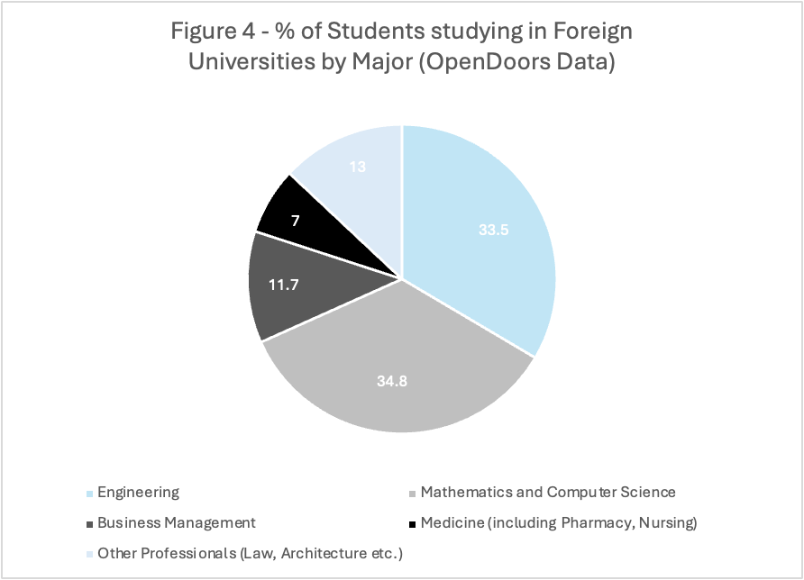

Slide 12
Regulatory Clarity: The Way Forward
Aaditya Agarwal: Maharashtra Institute of Transformation, National Institute for Transformation (NITIAayog: Government of India’s Policy Think Tank Chaired by Prime Minister)
A Maharashtra FHEI Facilitation Authority must be set up, which will enter into a Memorandum of Understanding with the Central government to get the required approvals efficiently and on time. This would include a complete Single-Window Digital Platform to streamline land approvals, visa guidelines, onboarding assistance, and academic accreditation requirements from interested FHEIs for Maharashtra.
To ease onboarding, Maharashtra should issue a model legal framework for all FHEIs in collaboration with DPIIT and RBI, operating either wholly as Indian subsidiaries (for-profit) granted special repatriation permissions, or Section 8 non-profits, contingent on whether the funds are reinvested in the country.
The fact that the regulatory bodies – the Bar, NMC, UPSC etc. do not recognize FHEI degrees is a larger, national contention, as the Government of Maharashtra cannot define the national equivalence protocol. The State should seek to work with UGC and Association of Indian Universities (AIU) to create bridge programs in partnership with Indian Universities for professional conversation.

Slide 13
Profit Model: The Current Problem
Aaditya Agarwal: Maharashtra Institute of Transformation, National Institute for Transformation (NITIAayog: Government of India’s Policy Think Tank Chaired by Prime Minister)
Under for the Foreign Exchange Management Act (FEMA), there are restrictions on the revenue and profit repatriation from the branch campus to the host university. The Indian campus’ revenue repatriation for curriculum licensing, brand name usage, access to technology systems and training, among other facilities would be considered as Fees for Technical Services (FTS), which induces a further 10-15% tax.
There is also skepticism that Indian students might not pay such high fees for domestic education, which would result in FHEIs only catering to urban and elite parts of society. This would directly undercut the inclusivity of the education system which currently brings together individuals from different socioeconomic backgrounds, due to exceptional pedagogy and low fees.
These universities are unlikely to charge lower fees than their host campus, which in the US is as high as $60,000) due to the UGC regulations mandating degree equivalence, which is extremely high compared to the $2300 - $5800) education offered by IITs and IIMs (~3600% the fees). (Refer to Figure 5)

Slide 14
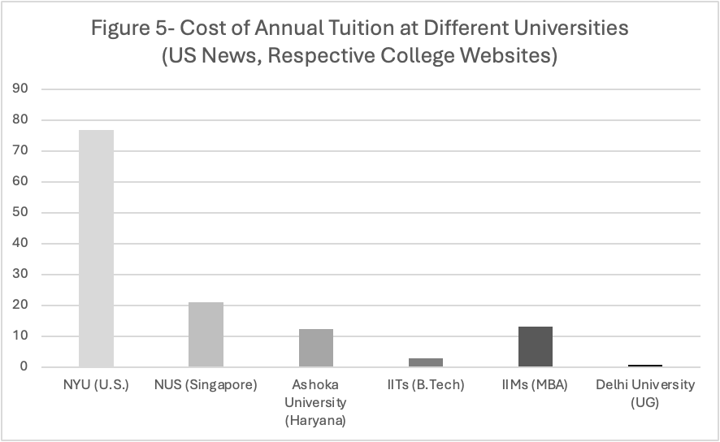

Slide 15
Profit Model: The Way Forward
Aaditya Agarwal: Maharashtra Institute of Transformation, National Institute for Transformation (NITIAayog: Government of India’s Policy Think Tank Chaired by Prime Minister)
To prevent unfavourable taxation models, the Maharashtra government should permit non-taxed repatriation of revenue and profits for registered FHEIs, backed by an RBI issued clarification on educational surplus repatriation not being in violation of FEMA. A ceiling of 5-8% of revenue for taxation, should also be instituted for FHEIs within Maharashtra.
The advantages discussed later must be clearly highlighted to the public. Additionally, surplus for these FHEIs limited within reasonable limits (such as is the practice for hospitals, and other social enterprises), and the Maharashtra government should set mandatory reinvestment thresholds and local benefit requirements (in the form of hiring, scholarships, grants, research etc.).

Slide 16
Fees Structure
Aaditya Agarwal: Maharashtra Institute of Transformation, National Institute for Transformation (NITIAayog: Government of India’s Policy Think Tank Chaired by Prime Minister)
Foreign universities offer differentiated tuition rates for domestic vs. international students (offering lower tuition for US citizens, and most state universities offering substantially lower rates for in-state residents). This could be replicated within Maharashtra, to provide cheaper, higher quality education for residents of Maharashtra and India.
Additionally, the State should work in conjunction with the FHEIs to develop need and merit-based scholarships, such as the Pell Grant and National Merit Scholarship Qualifying Test (NMSQT) respectively. Further in terms of scholarships, pre-existing government regulations on income-contingent scholarships and other need-based programs should be expanded to these FHEIs as well.
The government could subsidize fees structures, to offer tiered pricing based on income, reserving 15-25% for lower- and middle-income students below $9,400 yearly income)
FHEIs worry that Indian regulators might demand localization of curriculum and interfere with the medium of instruction, grading policies and other regulations that would affect operational autonomy and irectly reduce the quality of education imparted. The Government of Maharashtra, and India, must take steps to provide full pedagogical freedom available as is available in their country.

Slide 17
Advantages of FHEIs in Maharashtra
Aaditya Agarwal: Maharashtra Institute of Transformation, National Institute for Transformation (NITIAayog: Government of India’s Policy Think Tank Chaired by Prime Minister)
Quality of Education
Reduced Brain Drain
Job Creation
State Soft Power
Increased Innovation and Development
Social Inequality
Disadvantages of FHEIs in Maharashtra

Slide 18
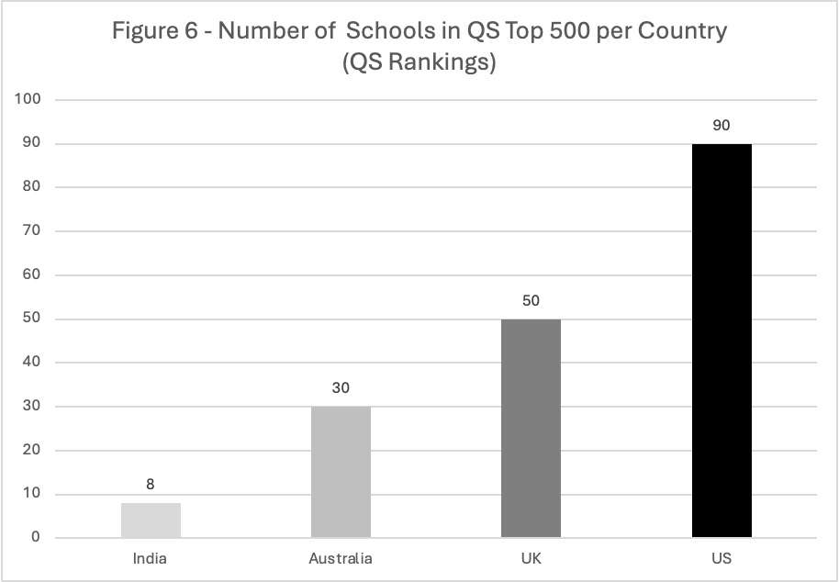

Slide 19
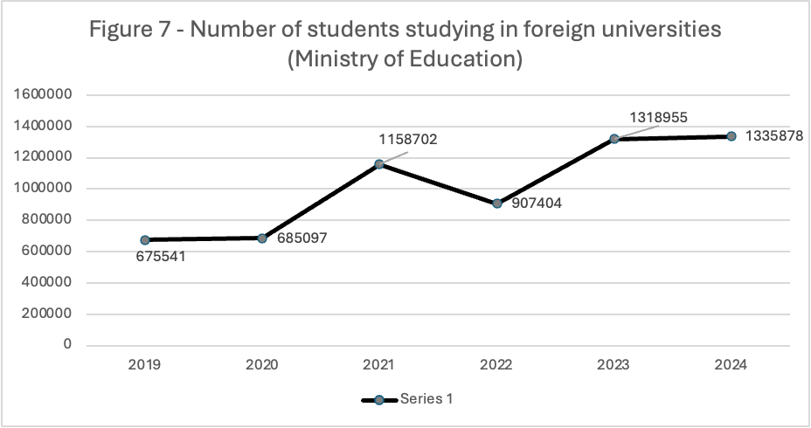

Slide 20
Impact-Based Assessment
Aaditya Agarwal: Maharashtra Institute of Transformation, National Institute for Transformation (NITIAayog: Government of India’s Policy Think Tank Chaired by Prime Minister)
Given the significant monetary and infrastructural contributions required from the Government of Maharashtra, it is important for these FHEIs to be positively impactful to the community. This requires a purpose-driven Strategic Public Benefit Assessment to ascertain the success of FHEIs set up, as emphasized and guided by Dr. Nancy Ruther of the Macmillan Center for International and Area Studies at Yale University. The State must mandate that all FHEIs participate in this impact-assessment framework, conducted not by independent body, assessing the metrics of Inclusivity, Academic Quality, Pedagogical Innovation, Faculty and Research Engagement, Post-Graduation Outcomes, and Community Benefit.

Slide 21
Metrics to Test through RCTs
Aaditya Agarwal: Maharashtra Institute of Transformation, National Institute for Transformation (NITIAayog: Government of India’s Policy Think Tank Chaired by Prime Minister)
Backgrounds Information on Inclusivity
- % of students from low-income families (<₹8L annual income)
- % of first-generation college students
- % of students from rural or Tier II/III cities
- % of students from reserved categories (SC/ST/OBC/EWS)
- % of students on full/partial scholarships
- % of female students
- % of students with disabilities

Slide 22
Aaditya Agarwal: Maharashtra Institute of Transformation, National Institute for Transformation (NITIAayog: Government of India’s Policy Think Tank Chaired by Prime Minister)
Academic Quality
- Average CGPA trends
- Student-faculty ratio
- % of faculty with PhDs or equivalent
- Course completion and on-time graduation rates
Pedagogical Innovation
- Number of interdisciplinary courses offered
- Number of courses taught using experiential or project-based learning
- Student feedback ratings on teaching quality
- Number of faculty granted full academic autonomy
Faculty & Research Engagement
- % of visiting faculty from home university
- Number of peer-reviewed publications annually
- Number of joint publications with Indian universities
- Research grant funding secured (domestic and international)
- Participation in Indian academic conferences

Slide 23
Aaditya Agarwal: Maharashtra Institute of Transformation, National Institute for Transformation (NITIAayog: Government of India’s Policy Think Tank Chaired by Prime Minister)
Post-Graduation Outcomes
- % of graduates employed within 6 months
- Average salary at graduation
- % of graduates pursuing higher studies (domestic and abroad)
- % of alumni retained in India post-graduation
Public Engagement & Community Benefit
- Number of local community programs and outreach efforts
- Number of local vendors or Medium and Small Enterprises (MSMEs) contracted
- Number of public seminars and academic workshops conducted
- Number of internships or apprenticeships offered to Indian students
- % of institutional surplus reinvested in Maharashtra

